Slide 1



Deposition of Alkanethiolate Self-Assembled Monolayers on Germanium
ViAnn Pham¹
Stacy Heslop², Anthony Muscat¹
Department of Chemical and Environmental Engineering¹
Department of Chemistry and Biochemistry²
University of Arizona
NASA Space Grant Symposium
University of Arizona - Tucson
Saturday, April 14, 2018

Slide 2
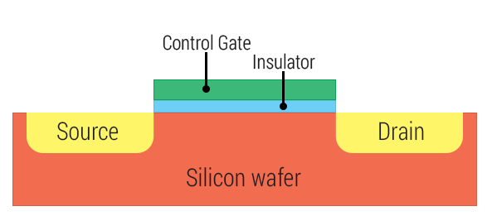


Motivation and Background
Problem: Ge form unstable oxides that inhibit device performance.
Need to find effective surface passivation method for Ge at reasonable time scales
Passivation layer = coat of protective material that reduces the amount of chemical reactivity on the surface
Material | Hole Mobility (cm² V/s)
Silicon | 200
Germanium | 450
Del Alamo, Jesús A. "Nanometre-scale electronics with III-V compound semiconductors." Nature 479.7373 (2011): 317-323.
https://www.androidcentral.com/sites/androidcentral.com/files/styles/xlarge/public/article_images/2015/01/Transistor.png
2

Slide 3
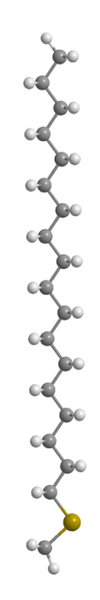
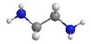
Motivation and Background
Use octadecanethiol (ODT) as passivation reagent.
Long-chain thiol
Used successfully in literature, but at long time scales (20 h)
Not practical for industry
Goal: reduce passivation time by adding ethylenediamine (EDA)
EDA converts thiol to thiolate.
Ge
3

Slide 4
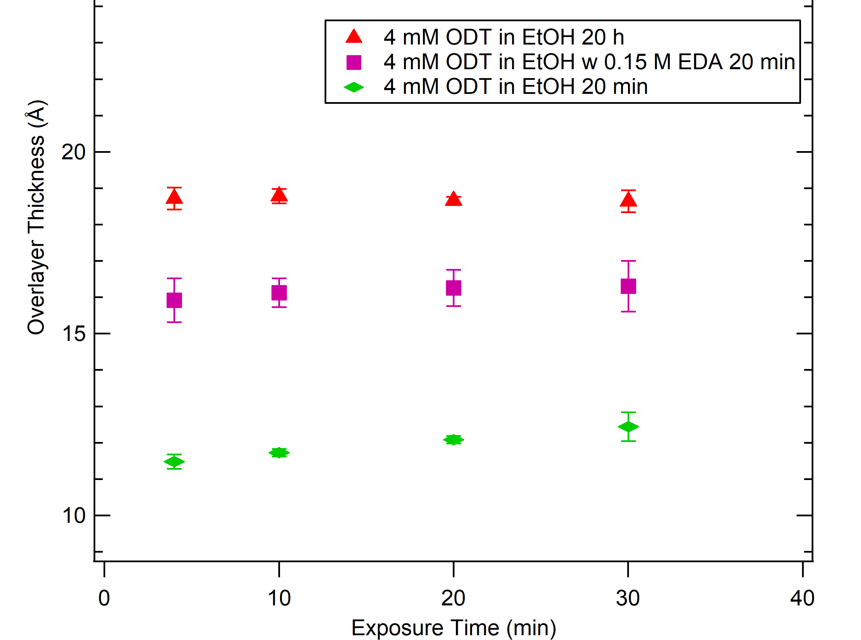
Adding amine increases layer thickness
Ideal overlayer thickness
4

Slide 5
Objective
Goal: Reduce the deposition time of a dense, highly-ordered alkanethiolate passivation.
Alkanethiolates
Ge
Ge
Control
Alkanethiolate-passivated surface
5

Slide 6
Procedure
Control
N₂ dry
Ge
SiGe 75%
Cleaning and etching
SC-1 or sonication
HF/HCl Oxide strip 5 min
Passivation
4 mM ODT in EtOH
w/ EDA (1.5 -150 mM)
RT vs 60°C
20 min vs 20 h
GeO₂
Ge
SiGe 75%
Ge
alkanethiolates
Ge
6

Slide 7
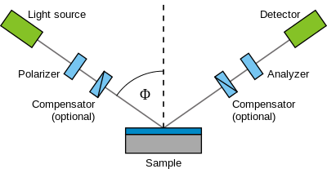
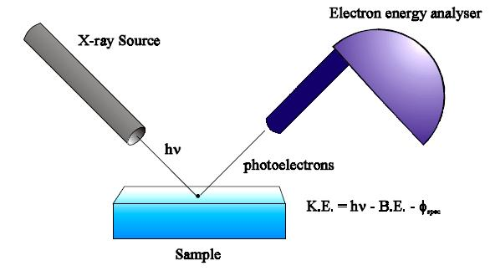
Characterization
Spectroscopic ellipsometry
Measured overlayer (oxides) thickness
X-ray photoelectron spectroscopy (XPS)
Determine chemical species on surface.
Wikimedia Commons
Wikipedia
6

Slide 8
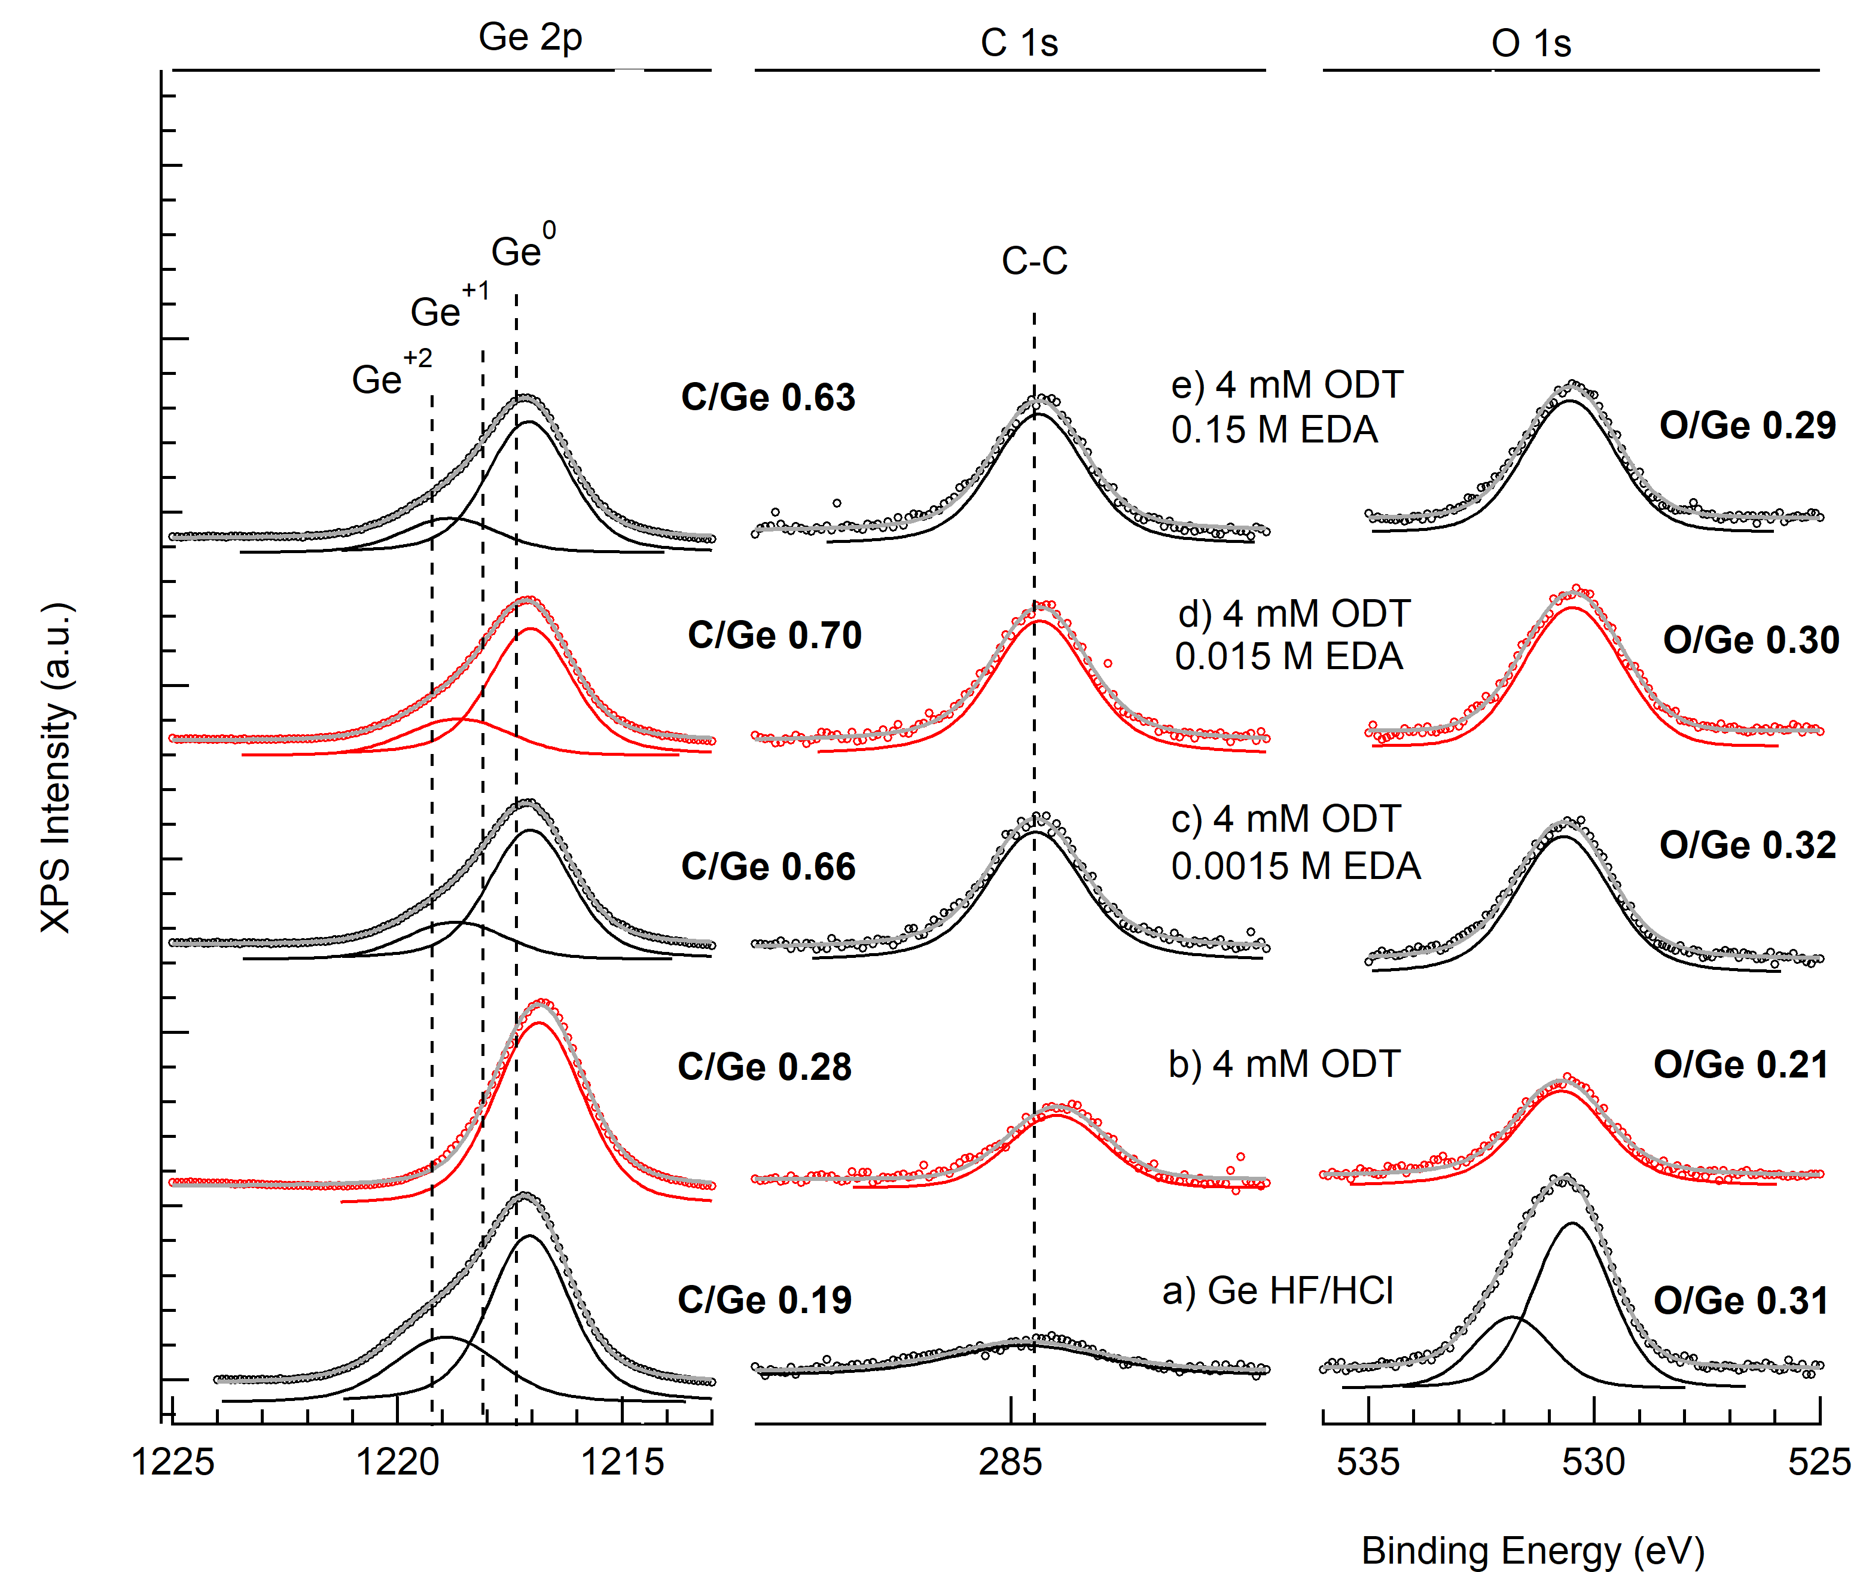
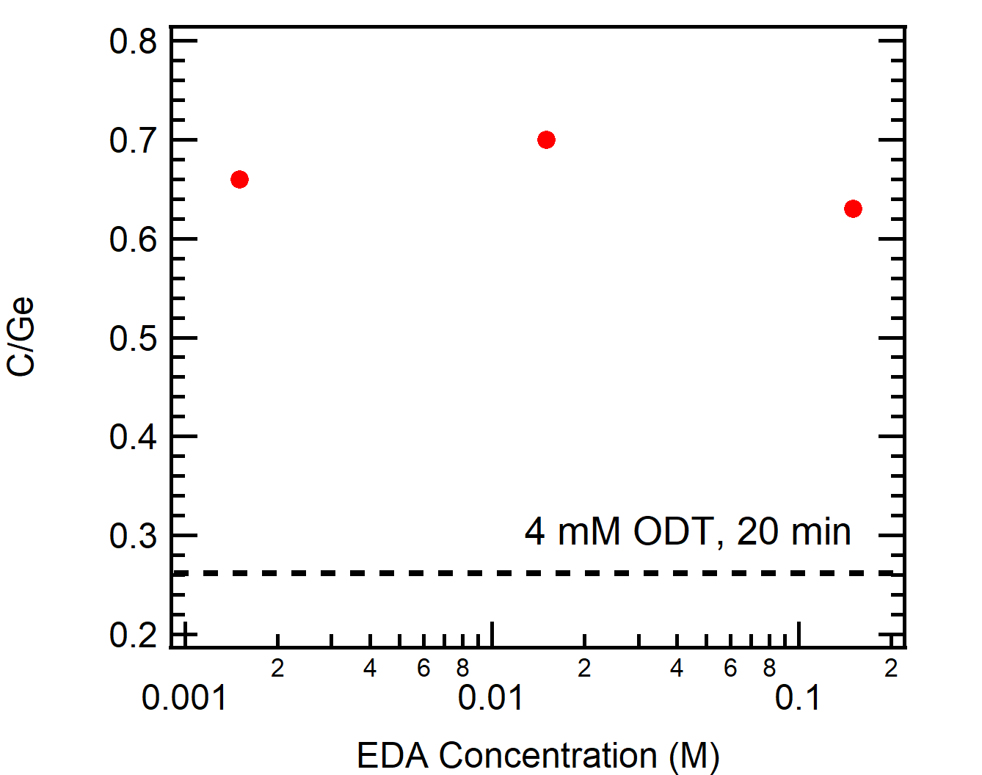
Amine increases carbon coverage
Amine does not oxidize the surface.
Concentration of amine does not affect coverage
7

Slide 9
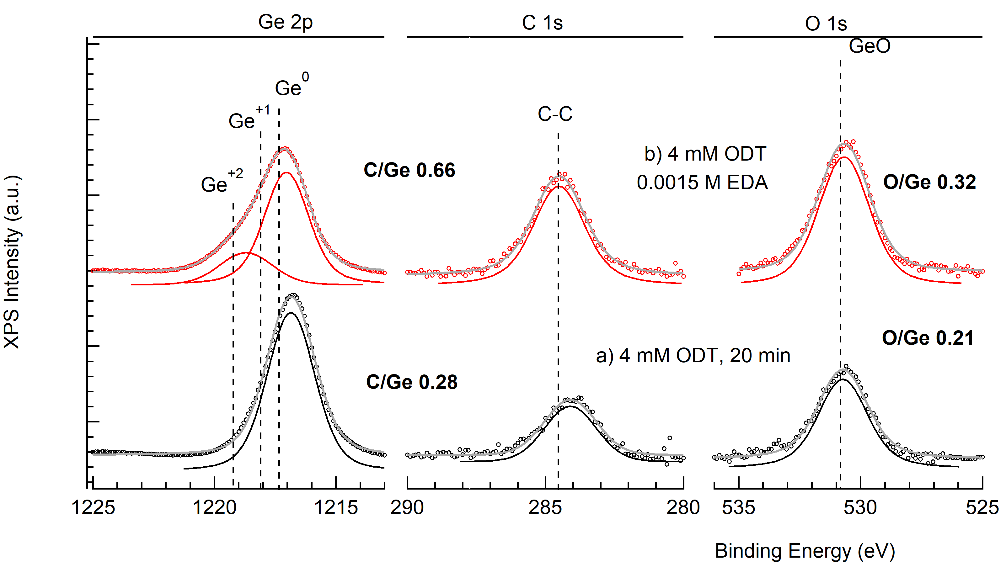
For 20 h immersion, amine decreases C/Ge ratio
At 20 h, thiol and amine solutions show a decrease in the C/Ge ratio than just thiol alone.
8

Slide 10
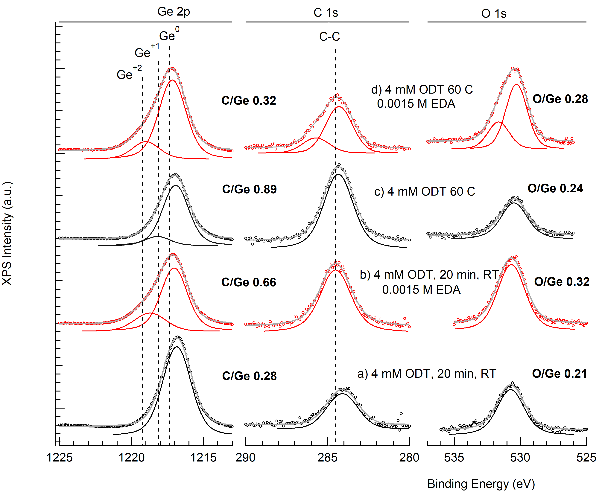
Increasing temperature with amine decreases C/Ge ratio
Increasing temperature increase C/Ge ratio for thiol alone, but decreases C/Ge ratio for thiol and amine solutions.
9

Slide 11
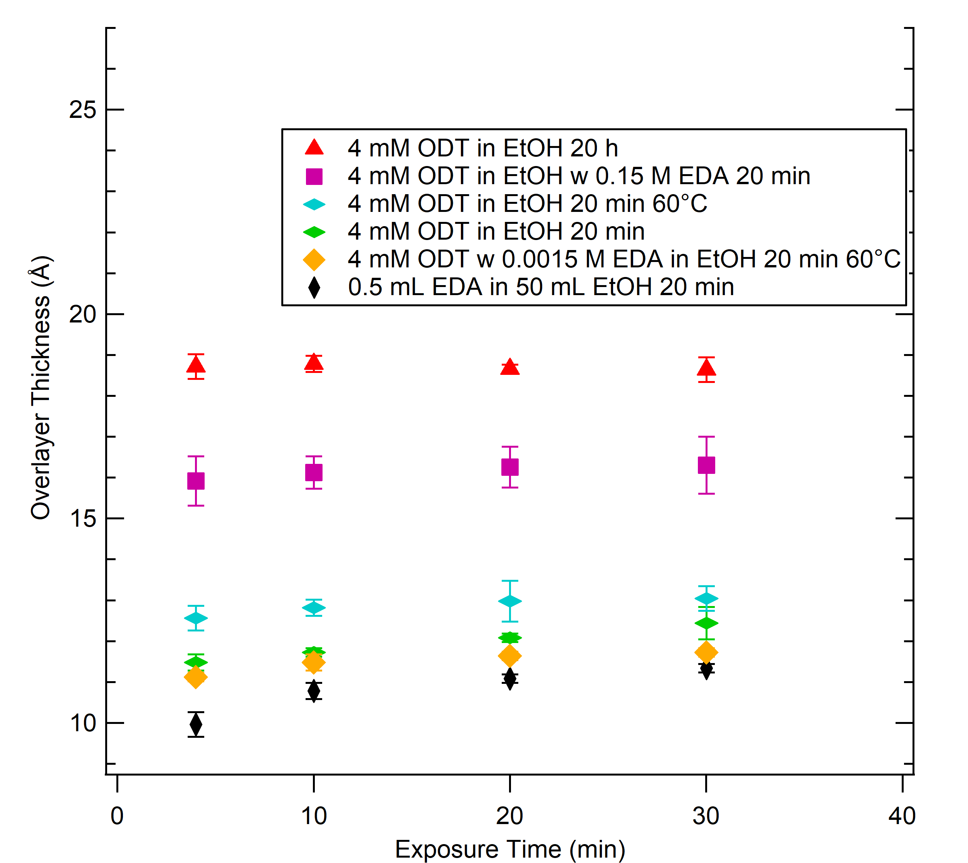
Overlayer thickness corroborates XPS results
With EDA, increasing T → Lower thickness
At 60°C, adding EDA → Lower thickness
At RT, adding EDA → higher thickness
ODT alone, increasing T → higher thickness
10

Slide 12
Conclusions
EDA helps at RT and does not contribute to oxidation.
20 h immersion produces a more dense and highly-ordered layer than 20 min immersion
Increasing temperature for solutions with EDA does not produce a more dense and highly-ordered layer.
Future Work
Confirm temperature trends.
12
Notes:
.

Slide 13

Acknowledgements
Muscat Research Group
NASA/Arizona Space Grant Consortium
Lam Research
13

Slide 14
Thank you!
14

